Slide 1
每日时事专刊
2026年04月28日

Slide 2
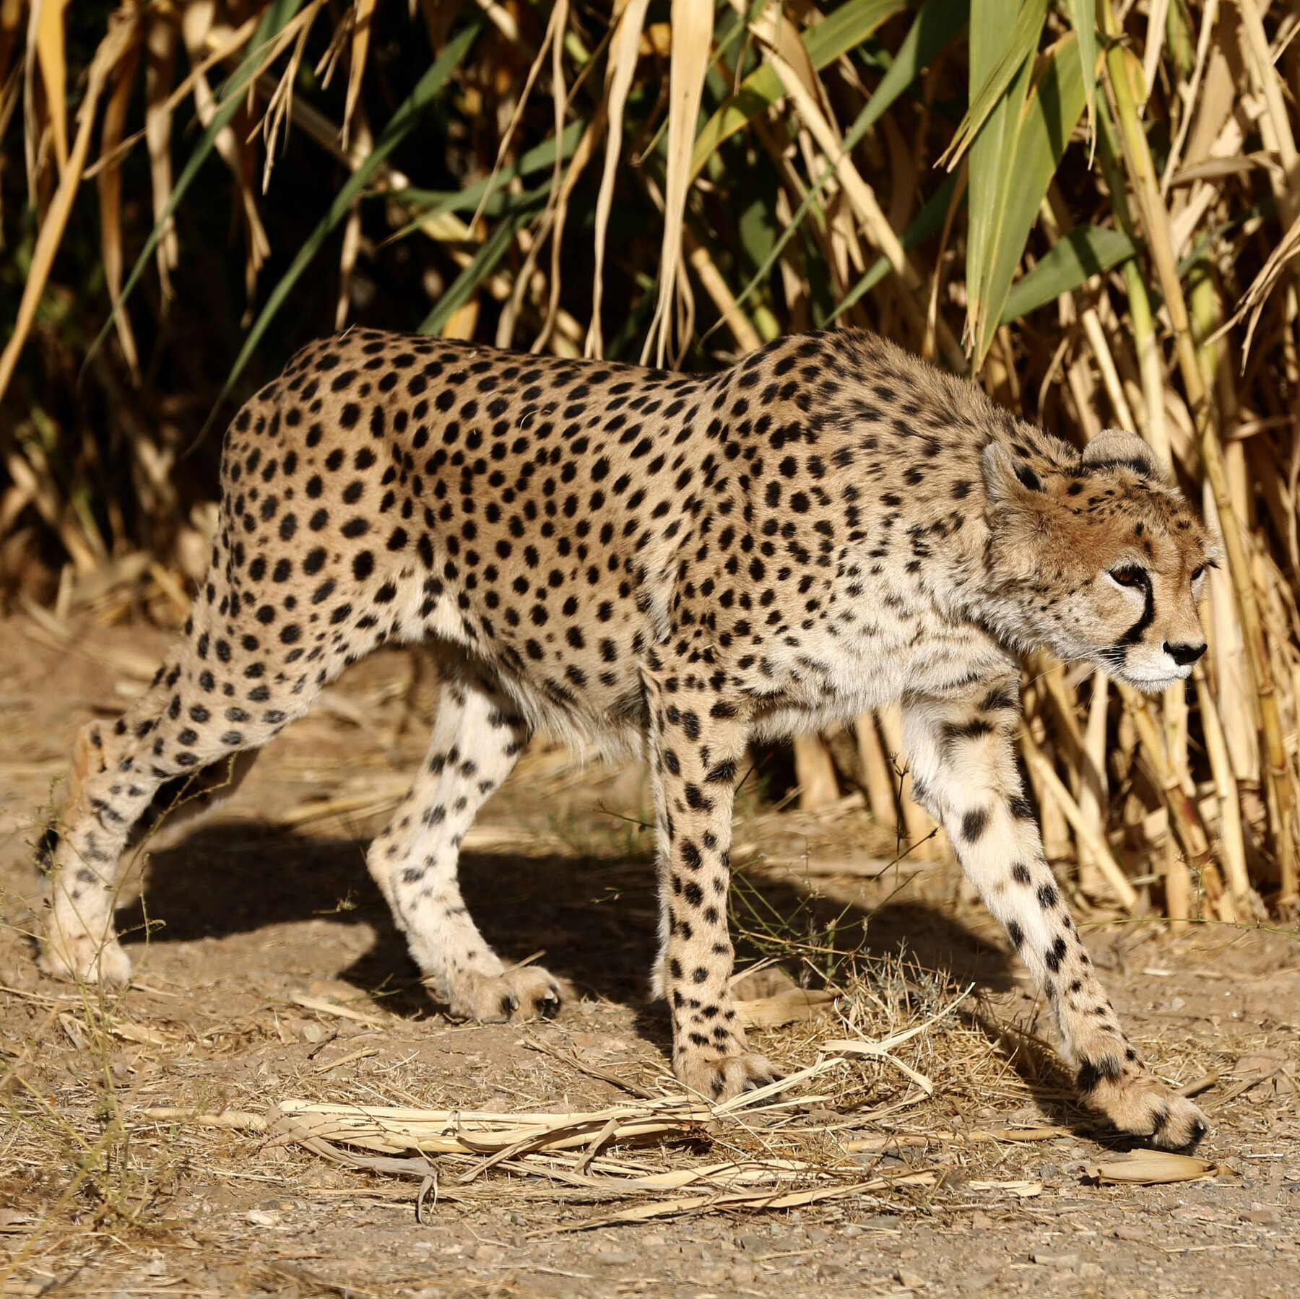
In Iran, Cheetah Sightings Offer Rare Spots of Hope Amid War (Translated to Chinese)
Conservationists say they have recorded several new adult and cub Asiatic cheetahs, a critically endangered subspecies found only in Iran. (Translated to Chinese)
来源: NYT World | 原文链接: https://www.nytimes.com/2026/04/28/world/middleeast/iran-cheetah-sightings-war.html

Slide 3

Death toll after train crash near Indonesia’s Jakarta rises to 14 (Translated to Chinese)
The head of the national rescue agency says efforts continue to remove people trapped in wreckage. (Translated to Chinese)
来源: Al Jazeera | 原文链接: https://www.aljazeera.com/news/2026/4/28/five-killed-in-train-crash-near-indonesias-jakarta-rescue-efforts-ongoing?traffic_source=rss

Slide 4
今日新闻总结
今日主要新闻概述：\n• In Iran, Cheetah Sightings Offer Rare Spots of Hope Amid War (Translated to Chinese)\n• Death toll after train crash near Indonesia’s Jakarta rises to 14 (Translated to Chinese)\n

